Slide 1
Display Images & Menus

Slide 2
Contents
ImageView
Display images
Display menus

Slide 3
ImageView
Key attributes:
android:id="@+id/theID" unique ID for use in Java code
android:src="@drawable/img" image to put in the screen (must correspond to an image resource)
android:scaleType: options are used for scaling the bounds of an image to the bounds of image view

Slide 4
ImageView - scaleType
CENTER : Displays the image centered in the view with no scaling.
CENTER_CROP : Scales the image such that both the x and y dimensions are greater than or equal to the view, while maintaining the image aspect ratio; centers the image in the view
CENTER_INSIDE : Scales the image to fit inside the view, while maintaining the image aspect ratio. If the image is already smaller than the view, then this is the same as center
FIT_CENTER : Scales the image to fit inside the view, while maintaining the image aspect ratio. At least one axis will exactly match the view, and the result is centered inside the view
FIT_START : Same as fitCenter but aligned to the top left of the view
FIT_END : Same as fitCenter but aligned to the bottom right of the view
FIT_XY : Scales the x and y dimensions to exactly match the view size. dDoes not maintain the image aspect ratio
MATRIX : Scales the image using a supplied Matrix class. The matrix can be supplied using the setImageMatrix method. A Matrix class can be used to apply transformations such as rotations to an image

Slide 5
Display images from local file
To change the visible image, in Java code:
get the ImageView using findViewById
call its setImageResource method and pass R.drawable.filename

Slide 6
Display images from URL - Picasso, Glide…
Add Internet permission:
<uses-permission android:name="android.permission.INTERNET" />
Setup
compile 'com.squareup.picasso:picasso:2.5.2'
Use
if (url == null || url.equals("")) { Picasso.with(context).load("error").placeholder(R.drawable.ic_loading) .error(R.drawable.ic_loading) .into(imageView); } else { Picasso.with(context).load(url).placeholder(R.drawable.ic_loading) .error(R.drawable.ic_loading) .into(imageView); }

Slide 7
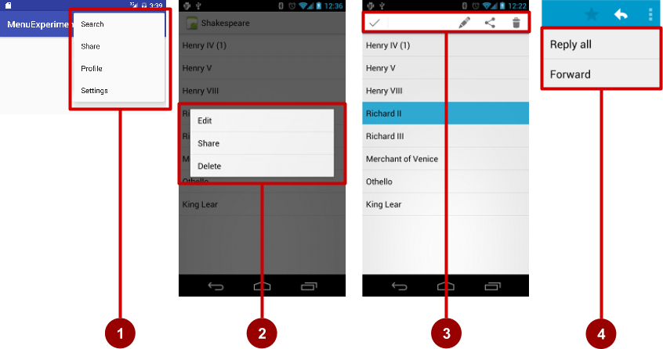
Display Menus
Types of menus:
App bar with options menu
Context menu
Contextual action bar
Popup menu

Slide 8
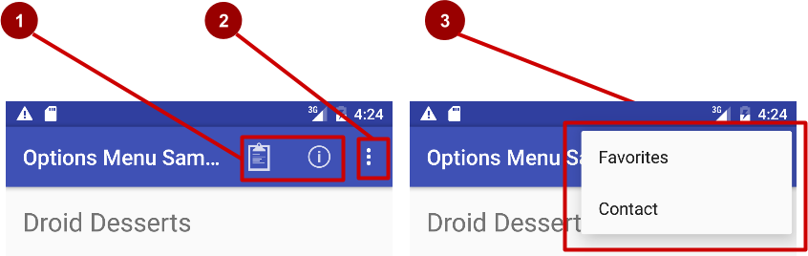

Options menu
Action icons in the app bar for important items (1)
Tap the three dots, the "action overflow button" to see the options menu (2)
Appears in the right corner of the app bar (3)
For navigating to other activities and editing app settings

Slide 9
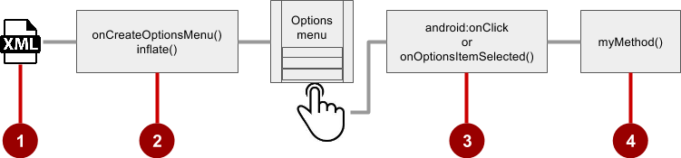
Options menu - Steps to implement options menu
XML menu resource (menu_main.xml)
onCreateOptionsMenu() to inflate the menu
onClick attribute or onOptionsItemSelected()
Method to handle item click

Slide 10
Options menu - Create menu resource
Create menu resource directory
Create XML menu resource (menu_main.xml)
Add entry for each menu item (Settings and Favorites):
<item android:id="@+id/option_settings"
android:title="Settings" />
<item android:id="@+id/option_favorites"
android:title="Favorites" />

Slide 11
Options menu - Inflate options menu
Override onCreateOptionsMenu() in Activity
@Override
public boolean onCreateOptionsMenu(Menu menu) {
getMenuInflater().inflate(R.menu.menu_main, menu);
return true;
}

Slide 12
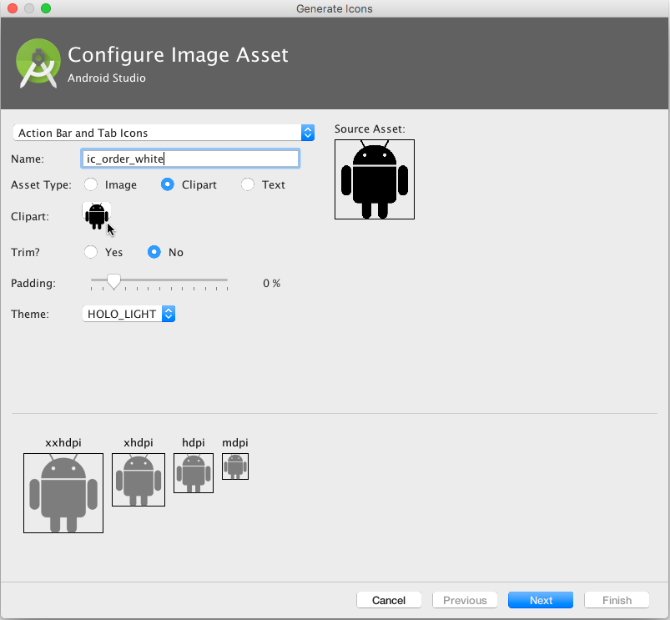
Options menu - Add icons for menu items
Right-click drawable
Choose New > Image Asset
Choose Action Bar and Tab Items
Edit the icon name
Click clipart image, and click icon
Click Next, then Finish

Slide 13
Options menu - Add menu item attributes
<item
android:id="@+id/action_favorites"
android:icon="@drawable/ic_favorite"
android:orderInCategory="30"
android:title="@string/action_favorites"
app:showAsAction="ifRoom" />

Slide 14
Options menu - Override onOptionsItemSelected()
@Override
public boolean onOptionsItemSelected(MenuItem item) {
switch (item.getItemId()) {
case R.id.action_settings:
showSettings();
return true;
case R.id.action_favorites:
showFavorites();
return true;
default:
return super.onOptionsItemSelected(item);
}
}

Slide 15
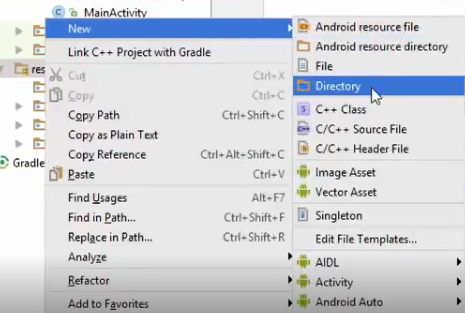
Demo option menu

Slide 16
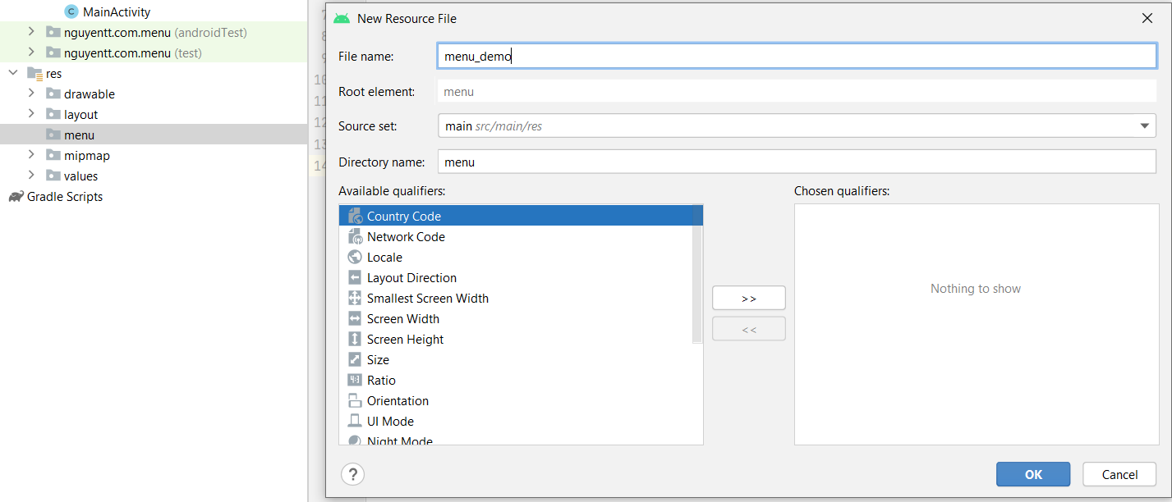

Slide 17
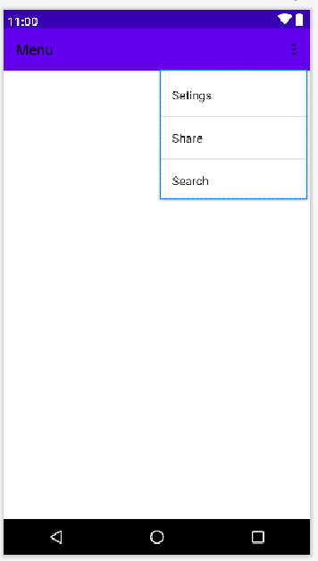
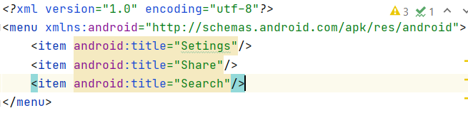
Trong menu_demo.xml thêm đoạn code sau

Slide 18
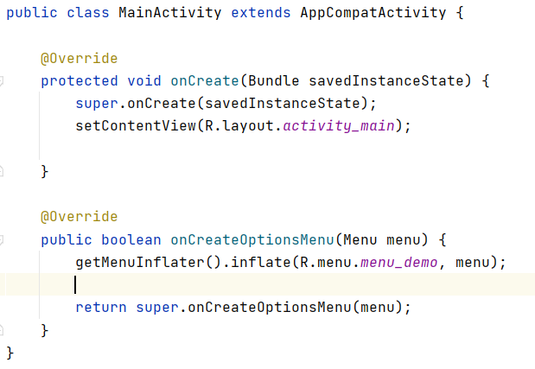
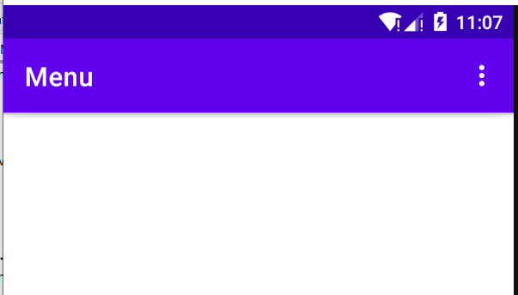

Slide 19
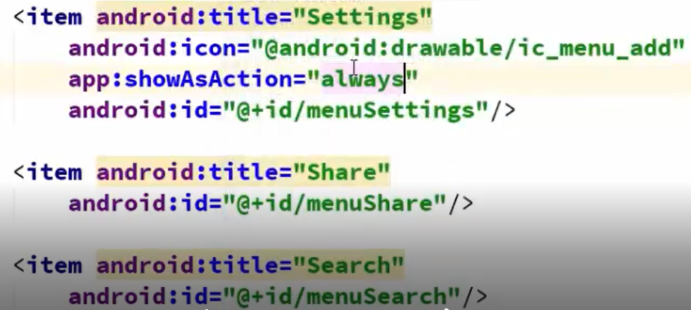
Bổ sung id cho các title
Run

Slide 20
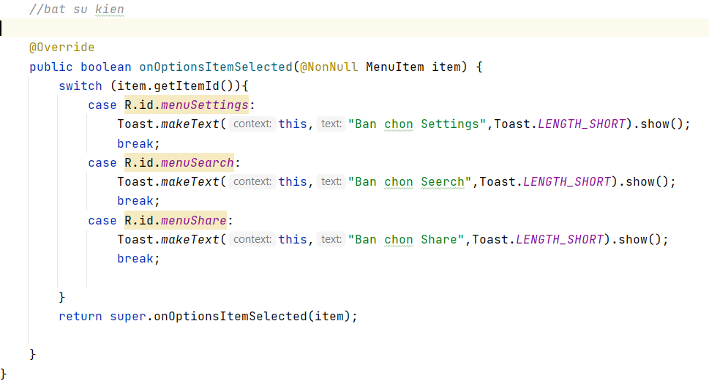

Slide 21
Contextual menus
Allows users to perform action on selected View
Can be deployed on any View
Most often used for items in RecyclerView, GridView, or other View collection
Notes:
Cho phép người dùng thực hiện hành động trên Dạng xem đã chọn Có thể được triển khai trên bất kỳ Dạng xem nào Thường được sử dụng cho các item trong RecyclerView, GridView hoặc bộ sưu tập Dạng xem khác

Slide 22
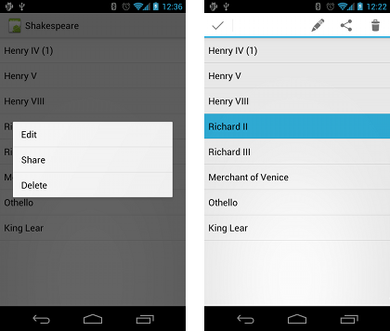
Types of contextual menus
Floating context menu—long-press on a View
User can modify View or use it in some fashion
User performs action on one View at a time
Contextual action mode—temporary action bar in place of or underneath app bar
Action items affect the selected View element(s)
User can perform action on multiple View elements at once
Notes:
Menu ngữ cảnh nổi—nhấn dài trên Dạng xem Người dùng có thể sửa đổi Chế độ xem hoặc sử dụng nó theo một cách nào đó Người dùng thực hiện hành động trên một Dạng xem tại một thời điểm Chế độ hành động theo ngữ cảnh—thanh hành động tạm thời thay cho hoặc bên dưới thanh ứng dụng Các mục hành động ảnh hưởng đến phần tử Dạng xem đã chọn Người dùng có thể thực hiện hành động trên nhiều yếu tố Dạng xem cùng một lúc

Slide 23
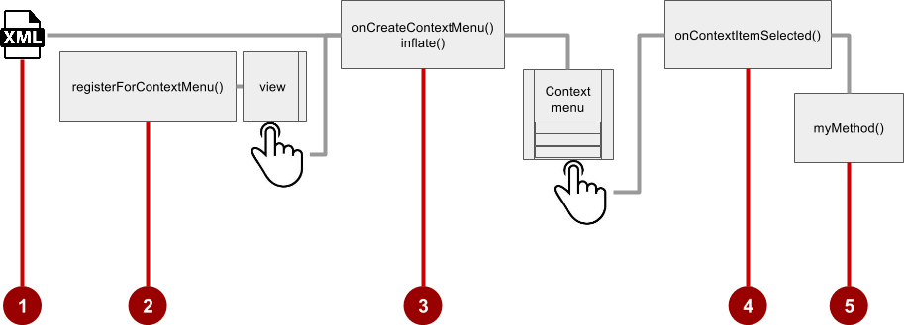
Context Menu implementation Steps
Create XML menu resource file and assign appearance and position attributes
Register View using registerForContextMenu()
Implement onCreateContextMenu() in Activity to inflate menu
Implement onContextItemSelected() to handle menu item clicks
Create method to perform action for each context menu item

Slide 24
1. Create menu resource
Create XML menu resource (menu_context.xml)
<item
android:id="@+id/context_edit"
android:title="Edit"
android:orderInCategory="10"/>
<item
android:id="@+id/context_share"
android:title="Share"
android:orderInCategory="20"/>

Slide 25
2. Register a view to a context menu
In onCreate() of the Activity, Register View.OnCreateContextMenuListener to View:
TextView article_text = findViewById(R.id.article);
registerForContextMenu(article_text);

Slide 26
3. Implement onCreateContextMenu() onCreateContextMenu() method
Specify which context menu
@Override
public void onCreateContextMenu(ContextMenu menu, View v,
ContextMenu.ContextMenuInfo menuInfo) {
super.onCreateContextMenu(menu, v, menuInfo);
MenuInflater inflater = getMenuInflater();
inflater.inflate(R.menu.menu_context, menu);
}

Slide 27

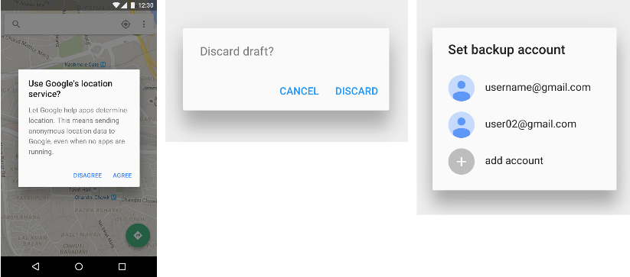
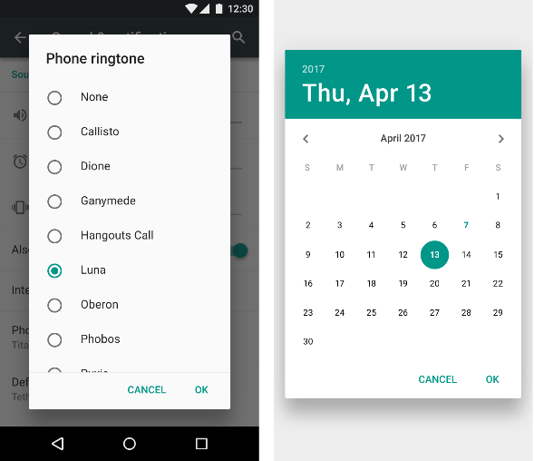
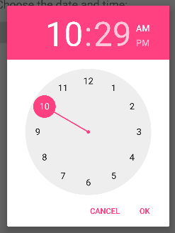
More things
Popup Menu
Dialog
Picker

Slide 28
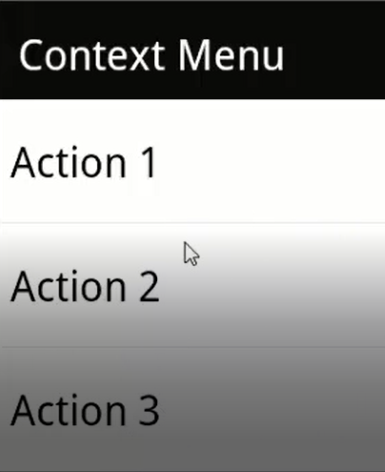
Demo Context menu
Long-Click

Slide 29
References
https://google-developer-training.github.io/android-developer-fundamentals-course-concepts-v2/

